Slide 1
ML-OPS FOR AUTO-TRIGGER GENERATION

Slide 2
Summary – 9 AUG-2024
1. Survey Report - Feasibility of Trgger Generation AI
Updating word document for:
Project Background
Value Proposition and Competitive Advantage Offered by MLOps
Objective
Goals
Overview of Automatic Trigger Generation System
Use-case: Rain detection
​
3. Auto Trigger Generation AI
Input pipeline analysis for auto trigger generation AI
Example Scene: Bright night with luminance Feature
Final condition generation visulization
Auto trigger generation AI considerations
Dynamic threshold
Feature selection and relevance
Feature distribution analysis
Co-relation with misclassification
Conditional logic formulation
Approaches for auto trigger generation AI
Statistical methods
Machine Learning models
Deep learning models
Generative AI
2. Use case Analysis
Flow understanding of Auto trigger generation
High level architecture
Input and output understanding
Case study: Rain Detection
Input data generation flow for Trigger Generation AI
Output generation flow for Trigger Generation AI by interpreting input data
Created revised plan for 1 month activities
Note : : completed
WIP: Work In Progress
2

Slide 3
1-month plan（DN rearrange）
 |  | Week1 (07/25 - 08/02) | Week2-3 (08/05 - 08/16) | Week4-5 (08/19 - 08/30)
Activities
Research Items | Trigger Generation AI | Flow understanding of Auto Trigger Generation High level analyzed architecture input and output requirements analysis Project scope (Trigger generation AI) Input and output understanding Case study with rain detection usecase | Trigger Generation AI module Input pipeline analysis AI model/ Libraries/ Open source model analysis Comparative analysis AI models Traditional ML Deep learning Gen AI Libraries Research: Tensorflow Pytorch Huggingface Technical architrave for Trigger generation AI module | Scene feature extraction module (part of input) Luminance extraction algorithm Scene text generation module (part of input) Algorithm/AI Model for scene text generator Comparative analysis AI models for Scene feature extraction and Scene text generation Traditional ML Deep learning Gen AI Libraries Research: Tensorflow Pytorch Huggingface
Output | 1 | Analysis report/deck: Use case analysis Conceptual Flow architecture | Comparative analysis report for Trigger generation AI AI Algorithms Libraries Opensource Model | Comparative analysis report for scene feature extraction and scene classification AI Algorithms Libraries Opensource Model
 |  |  | Comparison report with pros and cons which includes: Algorithm/model eligibility for usecase Amount of training data required for algorithm/model Amount of training time required for algorithm/model Complexities in Human in loop | Comparison report with pros and cons which includes: Algorithm/model eligibility for usecase Amount of training data required for algorithm/model Amount of training time required for algorithm/model Complexities in Human in loop
Ai Algorithms
Detailed solution architecture
Use case Analysis
Open Source Models
Final documentation

Slide 4
Auto Trigger Generation AI

Slide 5




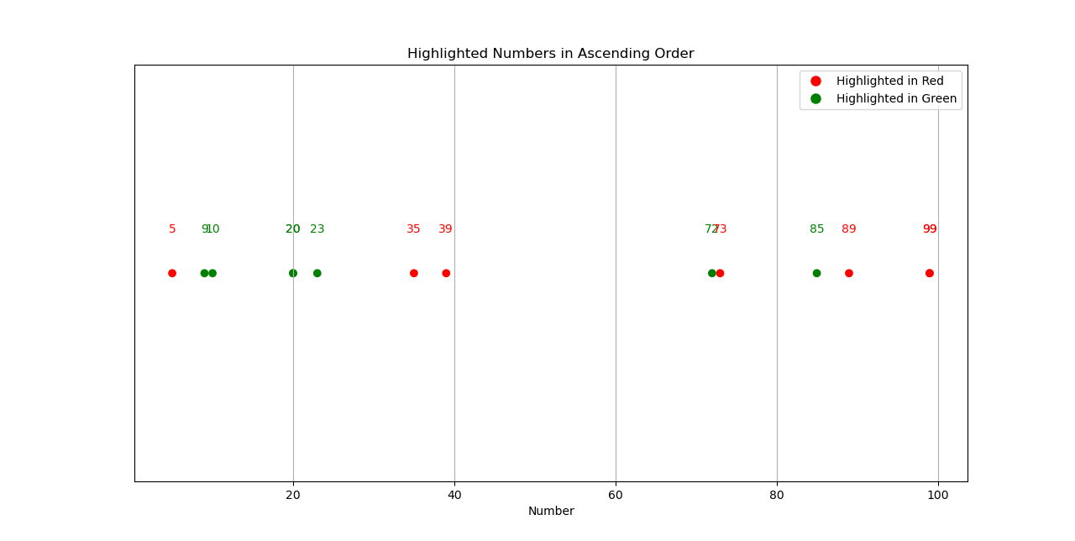
Input Pipeline Analysis
Bright Night
Scene Feature Extractor [Luminance]
10 | 5 | 9 | 35 | 99 | 20 | 85 | 72 | 39 | 89 | 99 | 20 | 23 | 73
Luminance value
Auto Trigger Generation AI
Miss classified
Classified Correctly
Trigger Condition file
Luminance [> 0 && <= 5]
Luminance
[>= 35 && <= 39]
Luminance
[>= 73 && <= 99]

Slide 6





Trigger Generation AI Consideration
10 | 5 | 9 | 35 | 99 | 20 | 85 | 72 | 39 | 89 | 99 | 20 | 23 | 73
Trigger Generation AI
Miss classified
Classified Correctly
Feature Selection and Relevance:
Ensure the selected features are relevant and contribute significantly to misclassification.
Filter out noisy or irrelevant features that may not impact the model's performance.
DynamicThreshold Optimization:
Experiment with different threshold values to identify optimal ranges where misclassification occurs.
Use statistical methods or optimization algorithms to fine-tune these thresholds.
Statistical Methods
1
Machine Learning
Feature Distribution Analysis:
Analyze the distribution of features in both misclassified and correctly classified images.
Identify patterns or anomalies in the feature distributions of misclassified data.
Trigger Generation AI Consideration
2
Deep Learning Models
3
Correlation with Misclassification:
Determine the correlation between specific feature values and the likelihood of misclassification.
Focus on features with high correlation to misclassification events.
Conditional Logic Formulation:
Develop logical conditions that combine multiple feature thresholds.
Ensure the conditions are neither too broad nor too narrow, capturing the critical misclassification scenarios.
Generative AI
4

Slide 7






Trigger Generation AI Models
Luminance
Trigger Condition Generation with Static Features
Trigger Condition Generation with Dynamic Features
on_road_objects
road_conditions
environmental_conditions
dynamic_features
Sceane_Description
Traffic_analysis
Trigger Condition file
[including dynamic threshold conditions of luminance and contrast]
Extracted Static Features
Scene Image
Scene Context
Contrast
Statistical Methods
Machine Learning
Deep Learning
Gen AI
Weak Point Estimation with Min-Max
BIRCH
Auto Encoders
LLM
Gaussian Mixture
Weak Point Estimation with Multiple Bins
Deep Embedding for Clustering (DEC)
Vision Transformers
DBSCAN
OPTICS
Variational Autoencoders (VAEs)
Sliding Window Analysis
Vision LLM
K-means
Chi-Square Test
Affinity Propogation
Self-Organizing Maps (SOMs)
Mean Shift
DeepCluster
Histogram Analysis
Spectral Clusturing
Agglomerative Clusturing
DCN (Deep Clustering Network):

Slide 8
Statistical Methods

Slide 9






Weak Point Estimation with Min-Max range
Feature
10 | 5 | 9 | 35 | 99 | 20 | 85 | 72 | 39 | 78 | 16 | 20 | 23 | 73
Ground truth
0 | 1 | 0 | 0 | 1 | 0 | 0 | 1 | 0 | 1 | 1 | 0 | 1 | 1
Predicted Results
0 | 0 | 0 | 1 | 1 | 0 | 0 | 1 | 1 | 0 | 0 | 0 | 1 | 0
1
2
3
4
Identify Misclassifications
(Compare Predictions with Ground Truth)
Extract Luminance Values (for Misclassified and Correctly Classified Images)
Determine Weak Point Range
(Min and Max of Misclassified Luminance)
Calculate Misclassification Rate
within Weak Point Range
5
6
Output
(Weak Point Range and Misclassification Rate)
Visualization
(Plot Results, Highlight Weak Point Range, Display Misclassification Rate)

Slide 10
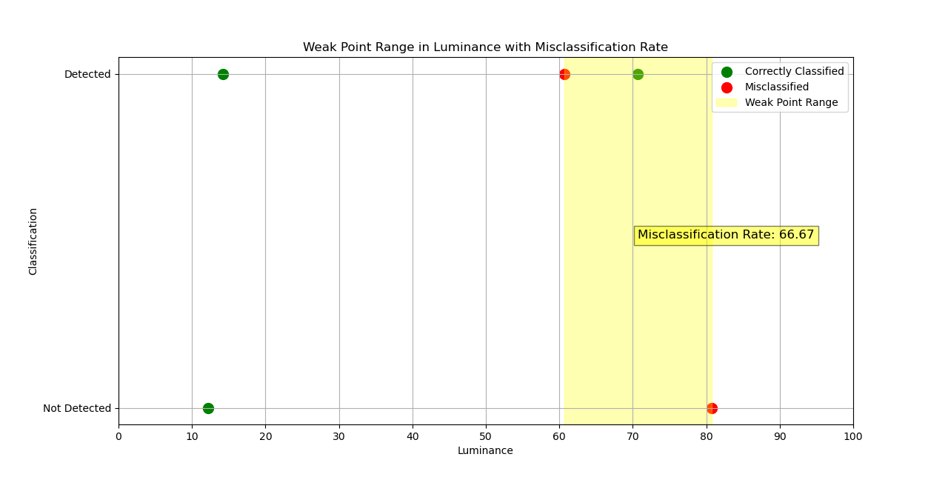
Weak Point Estimation with Min-Max range (example visualization)

Slide 11
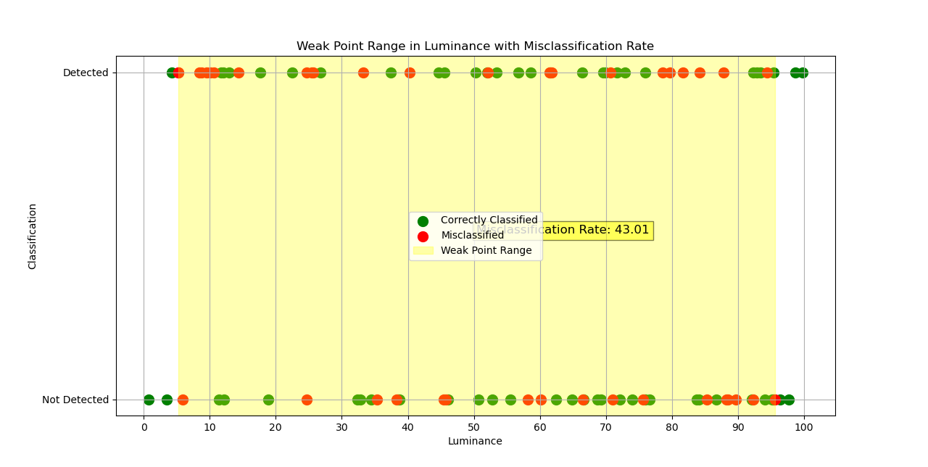
Weak Point Estimation with Min-Max range (example visualization)

Slide 12

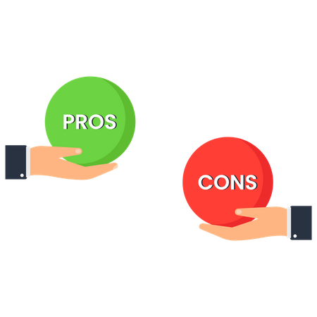
Pros & Cons
Simplicity
The method is straightforward and easy to implement. It uses basic statistical techniques and can be applied without requiring deep domain expertise.
Limited to One-Dimensional Analysis:
The method primarily focuses on a single feature (luminance in this case) and may not capture interactions between multiple features.
Direct Identification:
It directly identifies ranges where the model misclassifies, allowing for quick detection of problematic areas in the input feature space (e.g., luminance values).
Dependent on Data Distribution:
The effectiveness of the method can be sensitive to the distribution of luminance values in the dataset.
Visual Interpretation:
The method includes visualization, making it easy to interpret the results and understand where the model is failing.
Manual Threshold Selection:
The selection of the weak point range is based on the minimum and maximum misclassified values, which is a somewhat arbitrary choice.
Flexibility:
The approach can be adapted to other features beyond luminance, making it versatile for different types of data and models.
Lack of Generalization:
The identified weak point range may be specific to the current dataset and might not generalize well to other datasets or real-world scenarios.

Slide 13
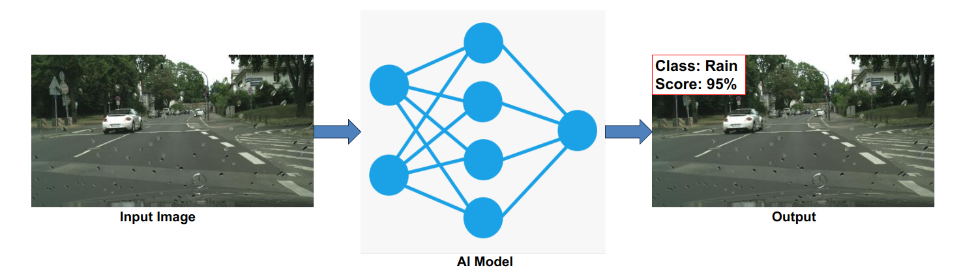


Weak Point Estimation with Multiple Bins
Feature
10 | 5 | 9 | 35 | 99 | 20 | 85 | 72 | 39 | 78 | 16 | 20 | 23 | 73
Classification Result
Pre-processing Layer
Luminance Binning
Divide luminance range into bins
Assign images to bins
Misclassification Calculation
Count correct/misclassified images
Calculate misclassification rate
Weak Point Detection Compare misclassification rates Identify and aggregate weak point ranges
Visualization Layer
Output Layer
Histogram and Scatter Plot
Plot histogram of luminance bins
Overlay classification data points
Weak Point Highlighting
Highlight weak point ranges
Annotate misclassification rates
Output Weak Point Ranges
Return weak point ranges Display final visualization

Slide 14
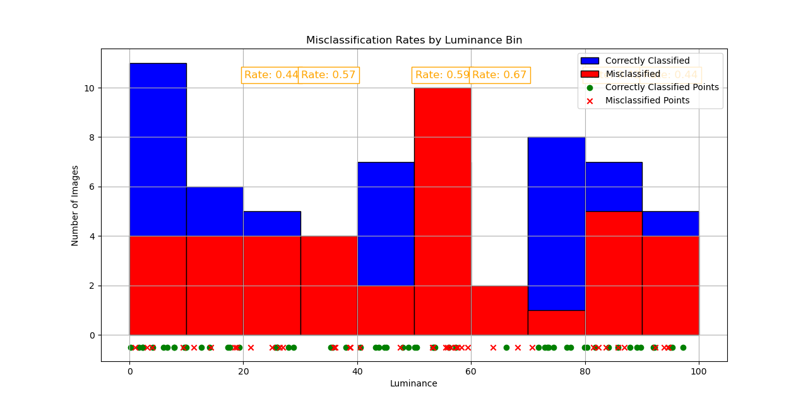
Weak Point Estimation with Multiple Bins

Slide 15
Pros & Cons
Simple and Intuitive
The approach is straightforward, making it easy to implement and understand. It uses basic statistical methods and visualization techniques to identify weak points
Sensitivity to Bin Size:
The choice of bin size can significantly affect the results. If the bins are too wide, weak points might be missed or over-generalized
Multiple ranges
By defining multiple bins will get multiple weak point ranges along with mis-classification rate
Limited Scope
may not generalize well to more complex scenarios involving multiple interacting features.
Visual Interpretation:
The method includes visualization, making it easy to interpret the results and understand where the model is failing.
Risk of Overfitting to Threshold:
If the misclassification threshold is set arbitrarily, there is a risk of either missing important weak points or identifying too many
Flexibility:
The approach can be adapted to other features beyond luminance, making it versatile for different types of data and models.
Manual Adjustment:
The method may require manual adjustments (e.g., in bin sizes, thresholds) to achieve optimal results,

Slide 16


Weak Point Estimation with Sliding Window
Feature
10 | 5 | 9 | 35 | 99 | 20 | 85 | 72 | 39 | 78 | 16 | 20 | 23 | 73
Classification Result
Misclassification Rate Calculation
Sliding Window Setup
Window Iteration
Set Window Size
Set Step Size
For each Window:
- Select Data in Range
- Count Correct
- Count Incorrect
Rate = Incorrect/Total
Compare Rate to | | | | Threshold
Visualization
Weak Point Detection
Plot Misclassification Rates
Highlight Weak Points
Overlay Data Points
Compare Rate to Threshold
Highlight High-Rate Regions

Slide 17
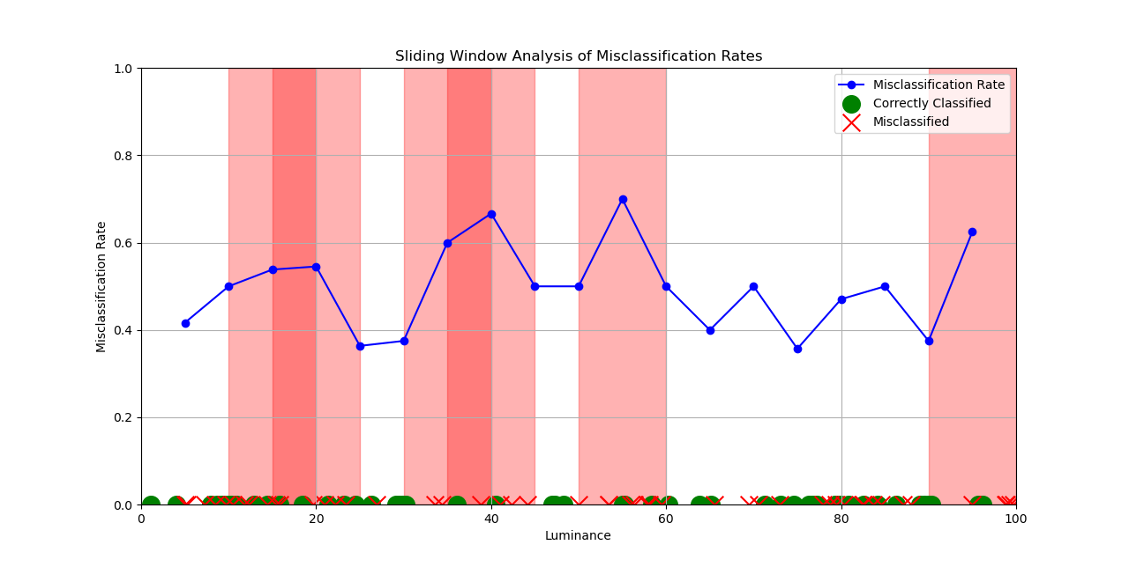
Weak Point Estimation with Sliding Window

Slide 18
Pros & Cons
Simple Implementation:
The method is straightforward to implement and does not require complex algorithms
Sensitivity to Window Size:
The choice of window size can significantly impact the results. A small window may lead to noisy results, while a large window might smooth out important details
Customizable:
The size of the sliding window and the step size can be adjusted to suit different needs
Overlapping Windows:
Overlapping windows may cause redundant calculations and could make it harder to interpret the results
Visual Interpretation:
The method includes visualization, making it easy to interpret the results and understand where the model is failing.
Threshold Dependency:
The identification of weak points is dependent on the threshold set for the misclassification rate
Flexibility:
The approach can be adapted to other features beyond luminance, making it versatile for different types of data and models.
Computational Efficiency:
While the method is generally simple, processing a large dataset with very small steps and window sizes can become computationally intensive

Slide 19
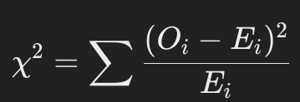
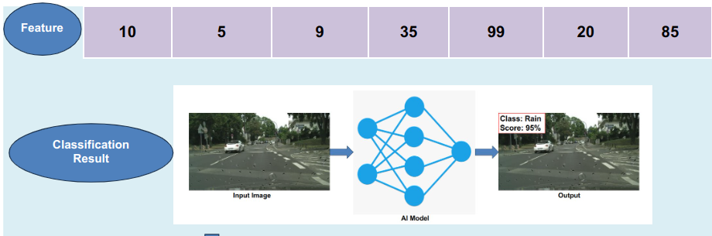
Chi Square Test
Purpose
The Chi-Square test is a statistical method used to compare observed frequencies with expected frequencies under the assumption that the variables are independent.
Use-case
Commonly used to test hypotheses about the distribution of categorical data and to determine if there is a significant association between two variables.
Oi is the observed frequency of the ith category.
Ei is the expected frequency of the ith category under the null hypothesis.
Key Components:
Specify Hyperparameters
Observed Frequencies:
The actual count of occurrences in each category (e.g., the number of correct and incorrect classifications in each bin).
Expected Frequencies
Binning Module
- Bin luminance
- Count correct and incorrect classifications
Contingency Table Construction
Create tables for observed and expected frequencies
The count of occurrences that would be expected in each category if the null hypothesis (independence between variables) were true.
Interpretation
Chi-Square Statistic:
A measure of the difference between observed and expected frequencies. Calculated as:
Weak Point Identification
- Analyze Chi-Square results
- Identify bins with significant p-values
Chi-Square Computation
- Calculate Chi- | | Square statistic| | and p-value
High Chi-Square Statistic
Low p-Value
Specify Hyperparameters
Indicates that the observed distribution is significantly different from the expected distribution, leading to rejection of the null hypothesis. Suggests a potential weak point in the model.
Indicates a large discrepancy between observed and expected frequencies, suggesting that the variables may not be independent.
Visualization
- Plot Chi-Square statistics, p-values, and misclassification rates - Highlight weak points
Low Chi-Square Statistic
High p-Value
Indicates that observed frequencies are close to expected frequencies, suggesting independence between variables.
Indicates no significant difference between observed and expected distributions, suggesting the differences are likely due to random chance.

Slide 20
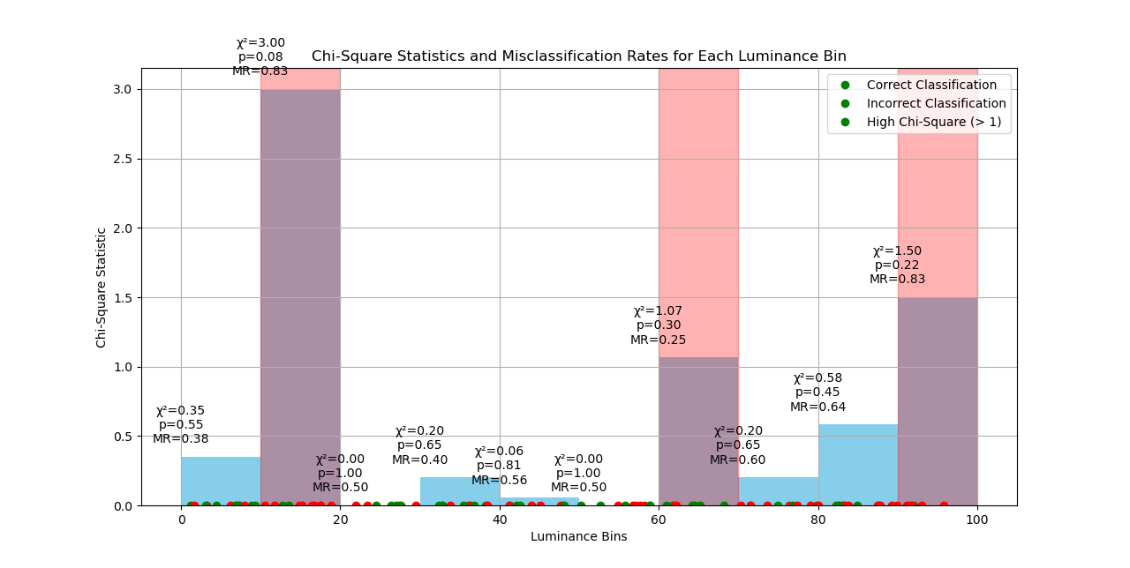
Chi Square Test

Slide 21
Pros & Cons
Simple and Easy to Implement
The Chi-Square test is a well-established statistical method that is straightforward to apply and understand
Limited to Categorical Data:
The Chi-Square test is only applicable to categorical data, so it may not be suitable for continuous data without binning
Good for Categorical Data:
The Chi-Square test is specifically designed to work with categorical data, making it suitable for analyzing classification results
Dependent on Bin Size
The choice of bin size can significantly impact the results. If the bins are too large, subtle weak points may be missed; if they are too small, the test may lack statistical power
Highlights Statistically Significant Differences:
The Chi-Square test identifies bins (ranges of luminance) where there is a statistically significant difference between observed and expected frequencies
Assumes Independence:
The Chi-Square test assumes that the observations are independent. If the luminance values or classification results are not independent, the test results may be invalid.
Interpretable Results:
The results of the Chi-Square test, including the Chi-Square statistic and p-value, provide clear indicators of whether the differences
May Not Detect Complex Weak Points:
The Chi-Square test may not detect weak points that arise from complex interactions between features or non-linear relationships
Identifies Model Bias:
The test can reveal if the model is biased towards certain ranges of input features (like luminance), indicating areas where the model may need improvement.
Potential for Misinterpretation:
A significant Chi-Square result does not necessarily mean there is a practical weak point in the AI model.

Slide 22
Use-case Analysis

Slide 23

Use-case Understanding (Case Study: Rain Detection)
Pre-existed
1 feature for this phase
Collected Data For Bright Night
Average Luminance | Time Stamp
75.14 | 23:16 PM
65.63 | 03:57 AM
59.41 | 02:53 AM
62.51 | 04:16 AM
Scene Data
Trigger ID
Trigger Condition
Scene (ex: bright night)
Scene Feature Extractor (luminescence, timestamp)
Maximum and minimum luminance values
Span of time
Minimum Luminescence: 59.41
Maximum Luminescence: 75.14
Synthetic Time Span: From 21:21 to 04:49
Scene ID: Bright Night
Input data generation flow for Trigger Generation AI

Slide 24
Use-case Understanding (Case Study: Rain Detection)
Average Luminance | Time Stamp
75.14 | 23:16 PM
65.63 | 03:57 AM
59.41 | 02:53 AM
62.51 | 04:16 AM
Scene Data
Evalution per Scene ID
Maximum and minimum luminance values
Span of time
Minimum Luminescence: 59.41
Maximum Luminescence: 75.14
Time Span: From 21:21 to 04:49
Scene ID: Bright Night
FAILED
Accuracy : 55%
Is matched with GT | Confidence
YES | 80 %
NO | 30 %
YES | 90 %
NO | 20 %
Extracted features of data set with
NG results
or
Extracted scene text
Output
Trigger Generation AI
Trigger File
Target CAN data: Luminance
Luminance>=60 && Luminance <=70 && Timstamp >= 03:00:00 && Timestamp <=05:00:00
Output generation flow for Trigger Generation AI by interpreting input data
Research points: Statistical/ml algo, Deep learning models, Gen AI models
Respected libraries

Slide 25
Thank You.

